Slide 1
PERSONAL FINANCE TRACKER
ELLEN KONDANI
Notes:
Hello, everyone. My name is Elllen Kondani, and today I will be presenting my project for the Python Programming module: a Personal Finance Tracker application

Slide 2
Project Overview & Objectives
Develop a graphical user interface using Tkinter for easy interaction.
Implement full Create, Read, Update, and Delete – or CRUD – operations on financial transaction data.
Incorporate robust error handling to ensure the application remains stable and provides helpful feedback to the user
Transaction summaries
Notes:
This application aims to provide a simple and user-friendly interface for individuals to manage their personal income and expenses. The core objectives of this project were – to → start reading the points one by one

Slide 3
Design Process & Methodology
Analyzing the project requirements outlined in the assignment.
Planning the basic structure of the application, including the database schema and the initial GUI layout.
Notes:
After reading the title say this → My development process involved an iterative approach. I started by:
After reading the points say this → In addition, I focused on building the core CRUD functionalities first, ensuring they were working correctly before moving on to enhance the user interface and add any additional features

Slide 4
Database Design
Id
Transaction_type
amount
category
date
description
Notes:
After mentioning the title of the slide say this → At the heart of the application is an SQLite database. The financial transaction data is stored in a single table called 'transactions'. This slide shows the schema of the 'transactions' table ←→then start reading the points.
After mentioning id say this → id is set as an integer which is also the primary key of this table and as well as it is automatically incremented
After saying transaction_type say this → transactional type have been set to TEXt where is it is indicating whether the transaction is income or expense.
After saying amount say this → amount has been set to REAL which is float point numbers since it is not always the case that money will be in whole numbers.
After saying category say this → This is just giving the category of that transaction and has been set to TEXT, for example, it can be food, accommodation, or clothing.
After saying date say this → Date in this table has been set to TEXT since it will be holding integers and characters like forward slashes.
After saying description say this → Description in my table has been set to TEXt since it will be holding a pile of texts but the difference between the description part and the other parts mentioned above is that in description the user will optionally input the description. In short, it is not compulsory for user to enter the description
Say this and go to next slide → SQLite was chosen for its simplicity and file-based nature, making it easy to integrate with the Python application.

Slide 5
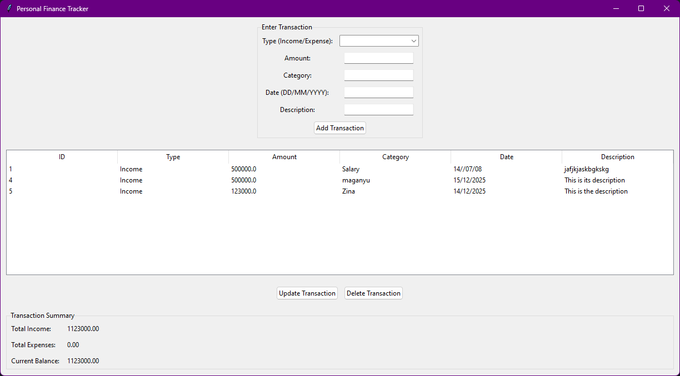
GUI Design & User Interface
Notes:
Say this after saying the title of this slide → The user interface was developed using Tkinter. As you can see in this screenshot, it's organized into several key areas
Say this while pointing to the top of the app → At the top, we have the input area, allowing users to enter details for new transactions, including the type, amount, category, date, and description.
Say this after saying about the top → The central part of the window displays the transaction history in a table format, showing all recorded transactions with their details.
Say this for the buttons of update and delete → Below the table, there are buttons to perform actions on selected transactions, such as 'Update Transaction' and 'Delete Transaction’ but unfortunately somehow the update button is not working as of now and it is still under implementation
Say this while pointing on transaction summary → Below the buttons is the summary of the transactions which is the total income, total outcome and the remaining money in pocket.
Say this to conclude the slide →
"The layout is designed to be natural, allowing users to quickly add, view, and manage their financial data.

Slide 6
Core Functionality - CRUD Operations
Create
Read
Update
Delete
Notes:
Say this after mentioning the title → The application provides full CRUD functionality for managing financial transactions
Say this after saying create → New transactions are added by filling in the input fields and clicking the 'Add Transaction' button. This data is then validated and stored in the SQLite database.
Say this after saying Read → All existing transactions are retrieved from the database and displayed in the transaction table upon application startup and after any data modification.
Say this after saying Update → To update a transaction, the user selects a row in the table, the details are populated in the input fields, and upon clicking 'Update Transaction', the changes are saved back to the database.
Say this after saying Delete → Selecting a transaction in the table and clicking 'Delete Transaction' will prompt the user for confirmation before removing the record from the database

Slide 7
Additional Features
Transaction Summaries
Notes:
Say this after saying Additional features → Beyond the core CRUD operations, I've also implemented the following additional features to enhance the application's usability:
Say this after saying transaction summaries →The application calculates and displays the total income, total expenses, and the current balance, providing a quick overview of the user's financial status.

Slide 8
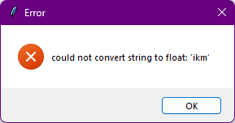
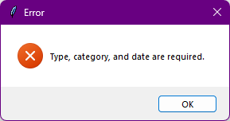
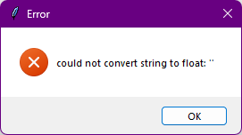
Exception Handling
Value Error
Empty Fields
Other Error
Notes:
Say this after saying Exception handling → To ensure the application is robust and user-friendly, I've implemented exception handling to manage potential errors. For example:
Say this while pointing to first screenshot → If the user enters non-numeric values in the 'Amount' field, the application will display an error message box, guiding them to enter valid data
Say this while pointing to second screenshot → The application also includes checks for empty required fields, prompting the user to fill them in before proceeding
Say this while pointing to third and other screenshots → These other errors will be shown due to the application logic misbehaving
Say this to conclude the slide → This error handling prevents the application from crashing and provides clear feedback to the user on how to correct any issues

Slide 9
Demonstration & Future Improvements
User authentication
Notes:
Say this and then close the presentation and demonstrate the app → At this point, I'd like to give you a live demonstration of the Personal Finance Tracker application, showcasing its key functionalities.
Say this after demonstrating the app → As you have observed, the application lacks security since no user log in functionality is there, the user authentication is under implementation and soon the application will be secured

Slide 10
The End
Notes:
Say this → Thank you for your time and attention. I'm now open to any questions you may have.

